Slide 1
Introduction to Relational Databases

Slide 2
What is a Database?
A database is an application designed to provide long-term storage of data.
Databases provide three critical features beyond data storage – data security, and efficient access, structural independence.
Databases ensure that only authorized people can make use of the data, typically with extensive and customizable data security configurations.
Databases ensure that just the right data items can be retrieved quickly (typically in less than a second) from amongst a potentially vast amount of storage.
Databases provide a level of abstraction so that applications are immune to server and file structure changes.

Slide 3
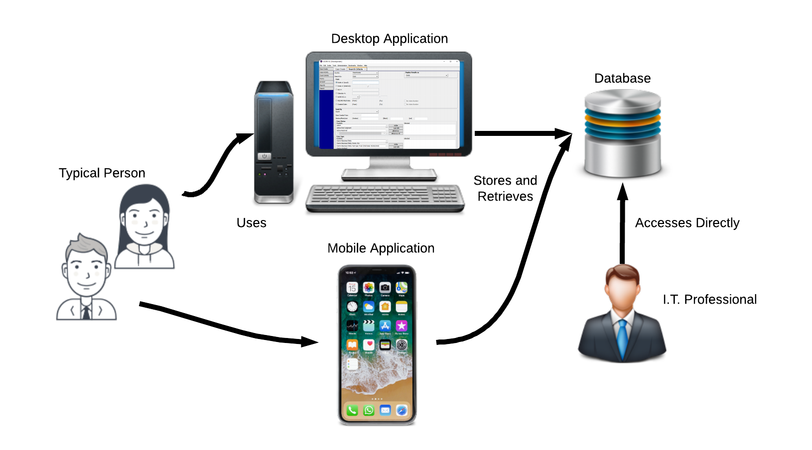
Typical Database Usage
Notes:
Virtually every organization (and most people) in the world uses a database directly or indirectly.
For-profit companies, not-for-profits, governments, clubs, and individuals use databases.
Almost all database access is indirect; people use an application which uses a database.
Websites such as Amazon.com
Mobile applications
Business applications
Applications, typically object-oriented, focus on managing transient types and on presenting interfaces to the end user.
The database’s role for the application is to store and provide access to durable types.
I.T. professionals such as database administrators, database developers, and data analysts, access the database directly.

Slide 4
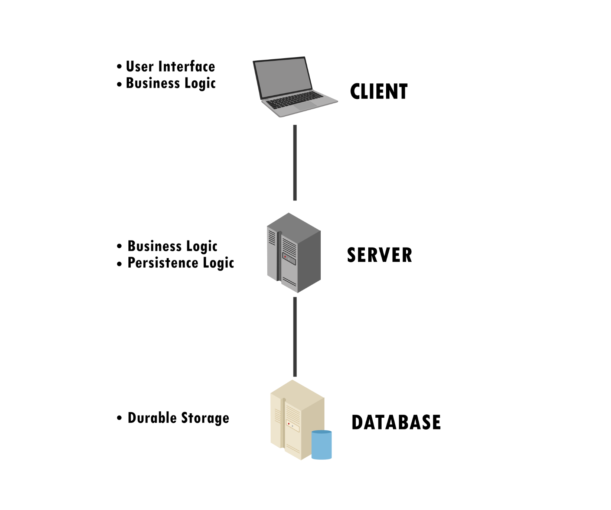
2-tier Client-Server Architecture
Notes:
Modern applications are becoming increasingly complex, and may require multiple user interfaces.
Modern applications have tiers, where each tier is specifically responsible for a portion of the overall application.
2-tier and n-tier client-server architectures are common.

Slide 5
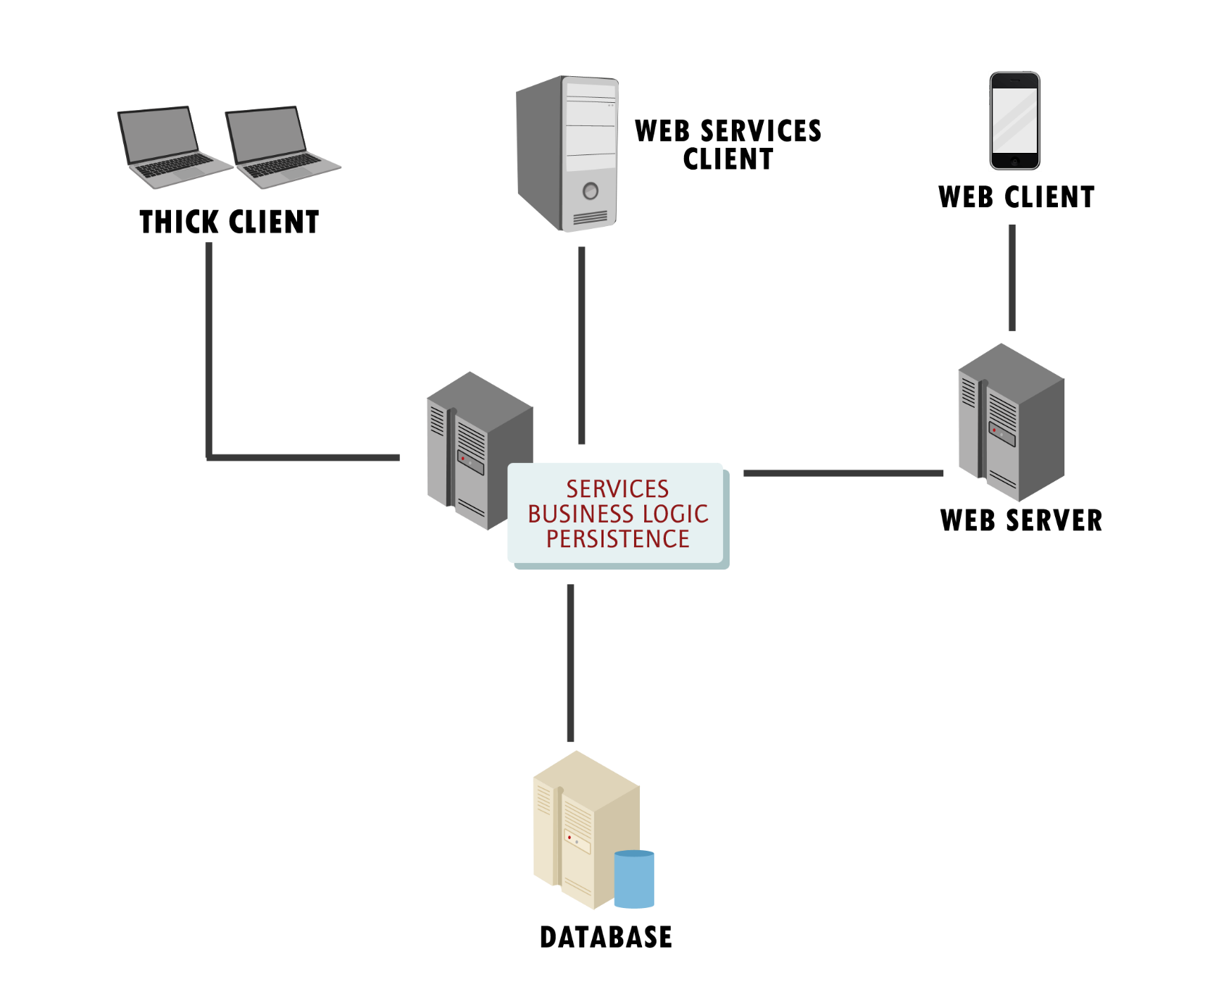
N-Tier Client-Server Architecture
Notes:
There can be different client types with n-tier.
Databases are developed for and in tandem with applications and information systems.

Slide 6
Database Popularity
Notes:
Relational databases are by far the most popular and used kind of database (Solid IT).
NoSQL and search databases are the most significant alternative.
Many texts treat “relational database” and “database” as synonymous terms.
Even the definition of alternative databases as “NoSQL” is a testament to the popularity of relational databases.
Relational databases are considered the foundational technology even if NoSQL databases are learned.
Works Cited
Solid IT (September 2018). DB-Engines Ranking. Retrieved September 4, 2018, from https://db-engines.com/en/ranking

Slide 7
Significant Databases
Relational
Oracle
SQL Server
NoSQL/Search
MongoDB
Elastisearch
MySQL
PostgreSQL
SQLLite
Redis
Cassandra
Notes:
Oracle is created by Oracle Corporation, SQL Server is created by Microsoft.
Both are in-demand commercial databases that are widely deployed worldwide.
PostgreSQL (aka Postgres) is an open-source database that has its origins in the Berkeley POSTGRES project starting in 1986.
Works Cited
Stack Overflow (2018, March 13). Most popular databases in 2018 according to StackOverflow survey. Retrieved September 4, 2018 from https://www.eversql.com/most-popular-databases-in-2018-according-to-stackoverflow-survey/

Slide 8
Major Differences Between DB Types
Relational
Declarative
NoSQL/Search
Imperative
Tabular
Broader User Base
Key/Value or Other
Restricted to Programmers

Slide 9
Relational Databases
A relational database is a collection of tables, indexes, sequences, stored procedures, triggers, and man other durable objects.
A relational database instance is the DBMS software installed on a specific computer and its associated storage.
Instances are what applications and people connect to for storing and retrieving data.

Slide 10
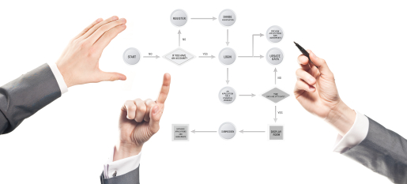
Data Modeling
Notes:
A model is:
A representation to show the construction of something (Dictionary.com)
A description to visualize something that cannot be observed (Merriam-Webster)
A data model, therefore, is a representation or description of data that describes the data.
Typically data models define the structure of the data and identify relationships in the data.
Data models provide a mechanism whereby many individuals to discuss, analyze, and change the implementation in a low cost manner.

Slide 11
The Relational Model
In 1970, E.F. Codd proposed a data model he termed the “relational model”.
It was deemed useful at the time, but hardware could not support it.
Fast forward, an overwhelming majority of databases in use today are relational databases.
Structured Query Language (SQL) is the universal language for relational databases.

Slide 12
Relational Feature: The Table
first_name | last_name | birth_date
Joe | Glass | 2/7/1973
Elaina | Goodwill | 10/27/1954
Elizabeth | Amaryte | 4/1/1983
Ifan | Element | 6/17/1944
Notes:
Much of the success of the relational model is because it uses a tabular construct, a two-dimensional structure consisting of rows and columns, at its core.
Columns have names and types of data allowed in them.
Most people understand tables. Consider the success of the Excel spreadsheet application.

Slide 13
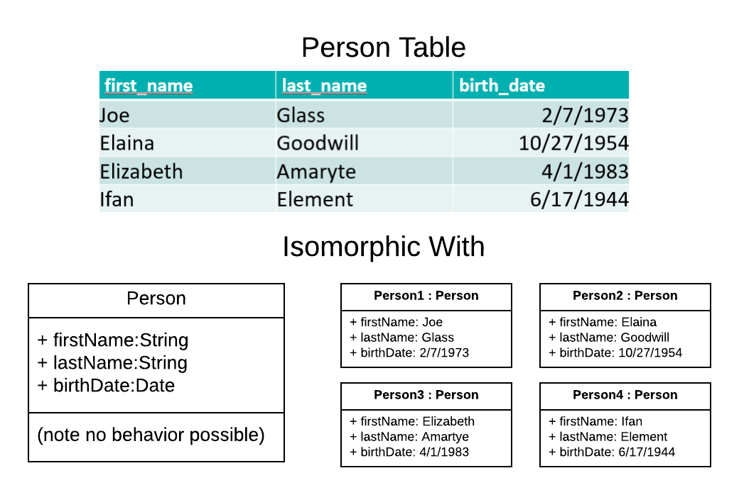
Relational Isomorphism
Notes:
A table is isomorphic with a Java class with no behavior and all public members.
Table columns are isomorphic with members of the class.
Table rows are isomorphic with objects of the class.

Slide 14

Relational Feature: Relationships

Slide 15
Relationships
When the same data value is duplicated in two different rows of the same or different tables, those rows are related
Rows in the same relation can be related
Rows in different relations can be related
This is a primitive form of a programming reference, such as:
MyType MyReference = new MyType();
References are tied to types and are more sophisticated; nevertheless, data duplication allows for basic referencing and relationships.

Slide 16
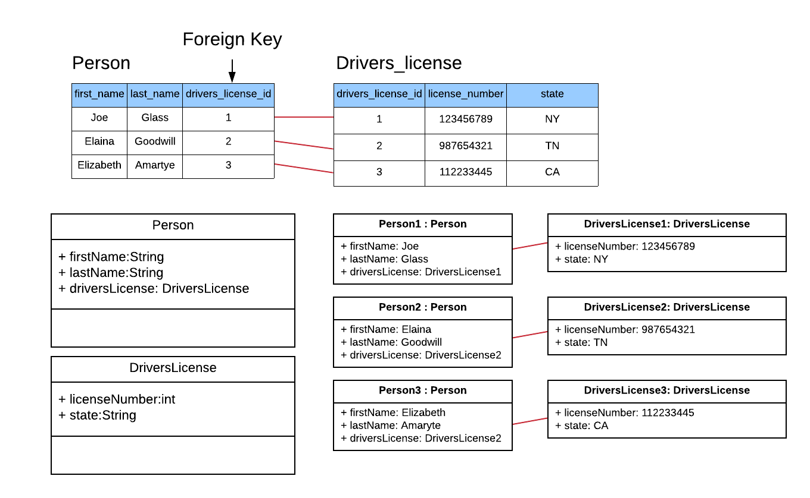
Relationship Isomorphism
Notes:
Notice that a reference has a type while relational model relationships are enforced with foreign keys.
Notice that references implicitly use addresses as identifiers (invisible to the app) while in the relational model the identifiers must be explicitly compared.

Slide 17


Relational Feature: Structural Independence
Example: Steering Wheel
Example: Car Pedals
Notes:
The principle behind structural independence and data independence is abstraction – a layer of objects which can be created, accessed, modified, or deleted without dependence on the particulars of the layer(s) below.
We rely on this independence (abstraction) every day in many areas.
For example, we know to press the gas pedal to go, the brake pedal to stop, and to rotate the steering wheel to turn.
While driving, we don’t concern ourselves with the throttle valve controlled by the gas pedal, the hydraulics and discs/shoes controlled by the brake pedal, or the pivoted joints controlled by the steering wheel. We just use them!
In fact, we can get into almost any car and use all three without having any knowledge whatsoever of how they were designed in that particular car.
Even better, how they work can change over time without changing how we use them. For example, the gas pedal today works with a throttle valve that is computer controlled, yet in times past no computer was involved!

Slide 18

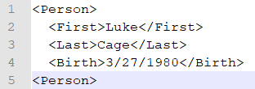

Structural Independence Example
This table:
could theoretically be laid out as:
First | Last | Birth
Luke | Cage | 3/27/1980
Text
XML
Binary
Notes:
A table is a virtual construct which the database can save in many different ways.
These virtual constructs must be stored permanently on disk in specific files with specific structures; however, we concern ourselves neither with files nor file structures when working with them.
The files and structures can change as needed.
The database instances can change.
Even the hardware itself can be changed, such as replacing a hard drive with a flash drive, or moving to a NAS device.

Slide 19
Integrity Constraints
Relational databases support 5 kinds of constraints on tables – primary key, foreign key, not null, unique, and check.
These low-level constraints are used to ensure basic data integrity.

Slide 20
Primary Key
A primary key is a column or set of columns that uniquely identifies every row.
Primary key values are used as the basis for creating a reference to a table.
You can think of a primary key as the “address” of a table row.
A primary key constraint enforces the fact that the column(s) are unique and not null.
Example: A person_id column in a Person table has a primary key constraint.

Slide 21
Foreign Key
A foreign key constraint enforces the fact that a reference is valid.
Each value specified in a foreign key column must exist in the table being referenced.
Example: An Employee table has a foreign key to an Address table via an address_id column. Any value in the address_id column in Employee must exist in Address (i.e. the reference must be valid).

Slide 22
Not Null
The not null constraint requires that every row in the table must have a value for that column.
Example: Often the last_name column in a Person table is not null so that a last name is required for every person.

Slide 23
Unique
A unique constraint requires that every value in the table for the column or set of columns must be unique (appear only once).
A unique constraint does not require the column be not null.
Example: A person table already has a person_id primary key, but also has a social_security_number field with a unique constraint to ensure every person’s number is unique (will catch bad data entry, for example).

Slide 24
Check
A check constraint supports for a Boolean expression that can involve any of the table’s columns, to check for cross-column integrity.
Example: Hourly Employees have the hourly_rate column filled in, and Salaried Employees have the salary column filled in, in an Employee table. A check constraint ensures that one of the fields has a value, and both cannot have a value (not possible with a not null constraint).

Slide 25

End

